Slide 1

How to Have a Relationship with God
The Central Message
of the Christian Bible

Slide 2
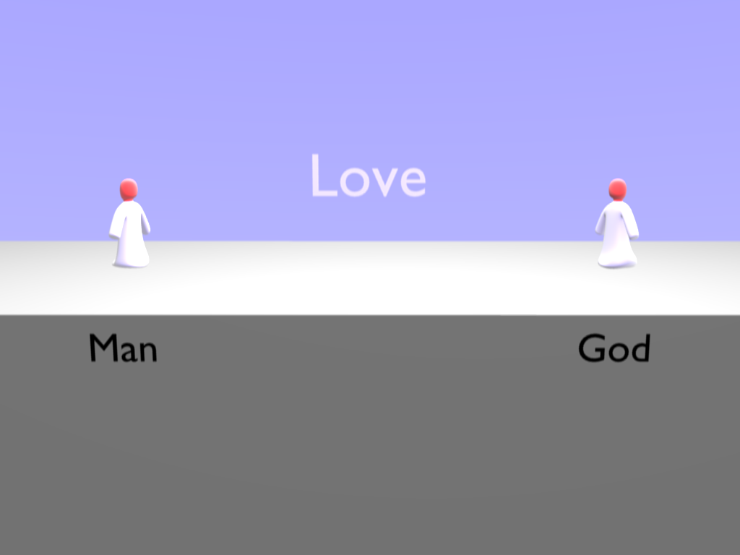
Notes:
God made Man to be in a Love relationship with Him forever. Love is what humans crave for; both to give and to receive God is love.

Slide 3
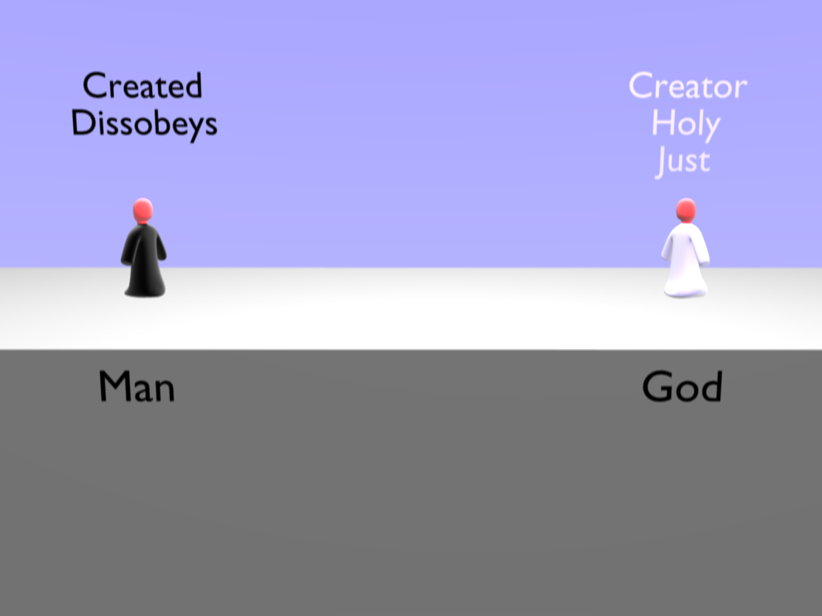
Notes:
Man was greedy and impatient, he decided to live for what he could have here and now, not caring what would happen in the future.

Slide 4
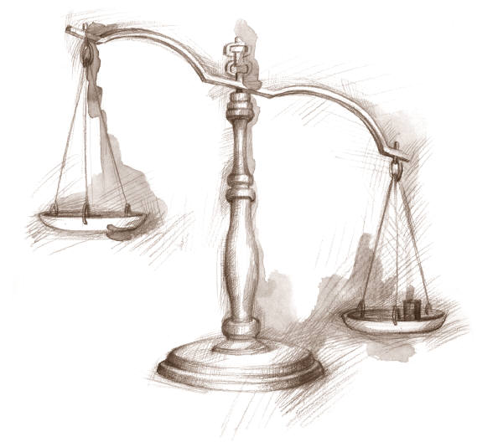

Slide 5
GUILTY
NOT GUILTY

Slide 6
Paul’s Letter to the Romans 3:23
For all have sinned and fall short of the glory of God.

Slide 7
Isaiah 59:2
Your iniquities have made a separation between you and your God, and your sins have hidden His face from you so that He does not hear.

Slide 8
Romans 6:23
The wages of sin is
death.
(“hell”)
(complete separation from God)

Slide 9
Matthew 7:21-23
Not everyone who says to me, ‘Lord, Lord,’ will enter the kingdom of heaven…many will say to me, ‘Lord, Lord, did we not do many mighty works in your name?’ And then will I declare to them, ‘I never knew you; depart from me…’

Slide 10
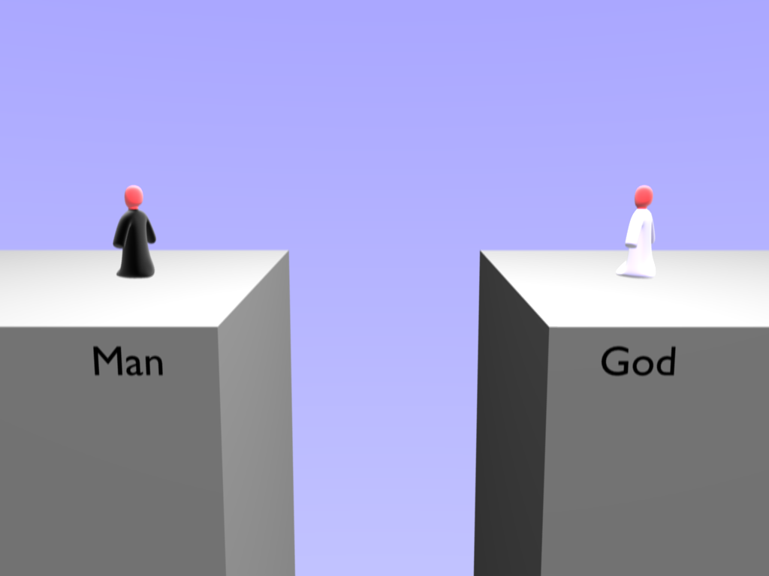
Death
Hell

Slide 11
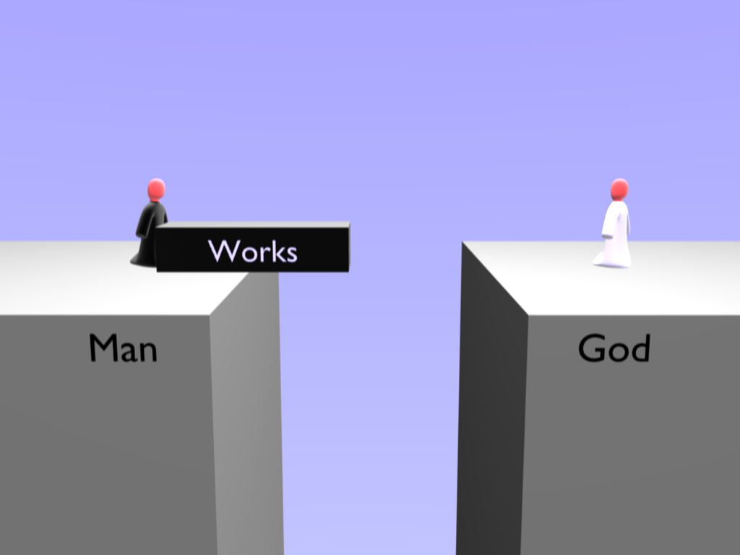
Notes:
Man hated this situation and tried make things right with God by good works and religious activity.

Slide 13
Isaiah 64:6
​​​​​​​We have all become like one who is unclean, and all our righteous deeds are like a polluted garment…

Slide 14
GUILTY
NOT GUILTY

Slide 15
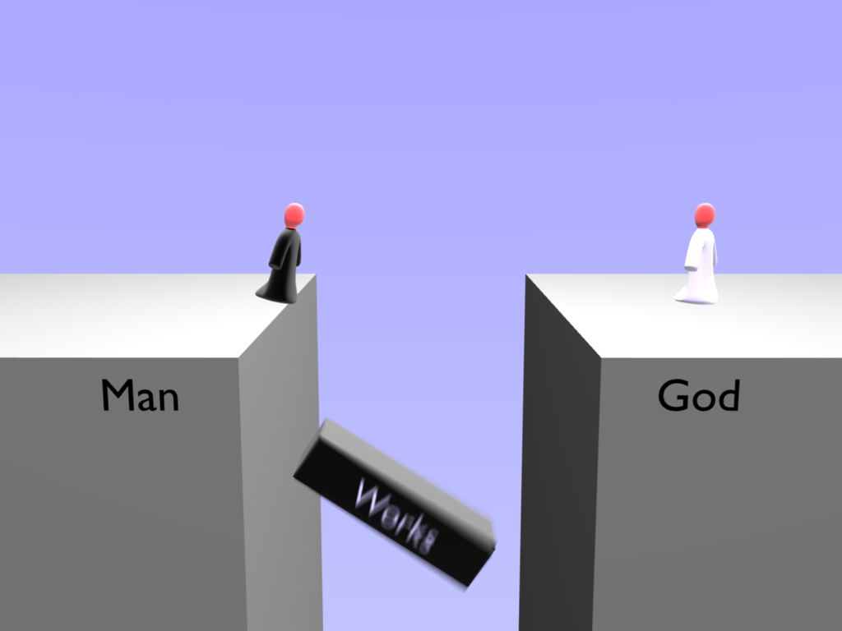
Notes:
It was no good, no amount of doing good will make a person pure once they have become impure. Even Man's attempts at good works stank to God. Rather than making things better they made things worse because Man became proud of his works.

Slide 16
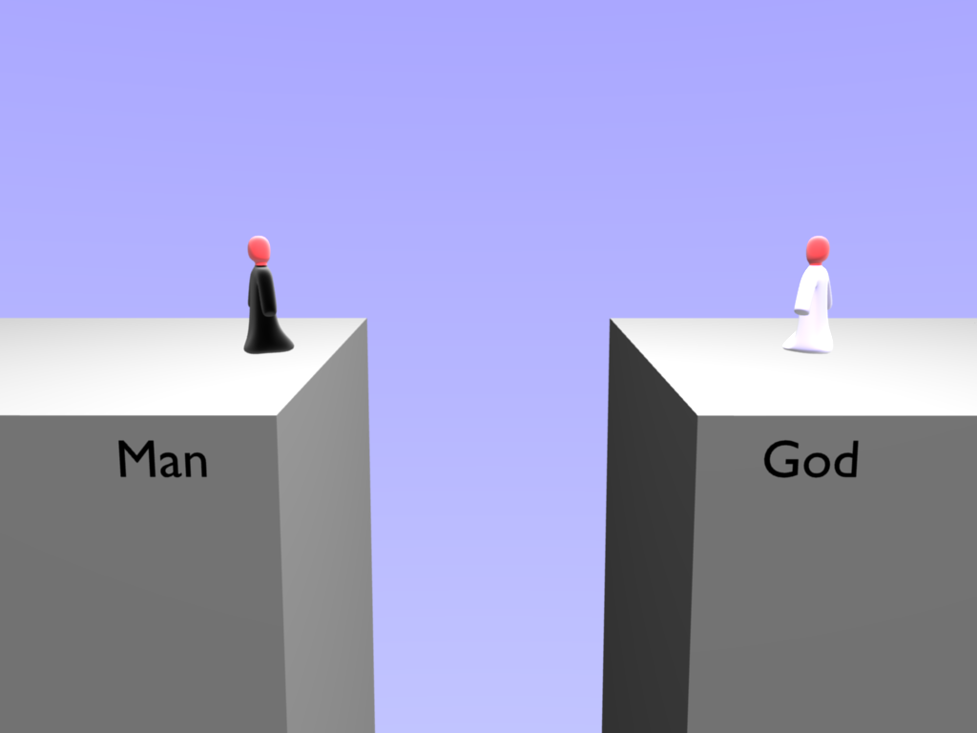
Notes:
But God was not happy with this situation because he still loved Him. The only way for Man to come back to God was if God made a way. God loved Man so much He sent His own son Jesus to become a human being to be born as a Man.

Slide 17
John 3:16
For God so loved the world, that He gave His only Son, that whoever believes in Him should not perish but have eternal life.

Slide 18
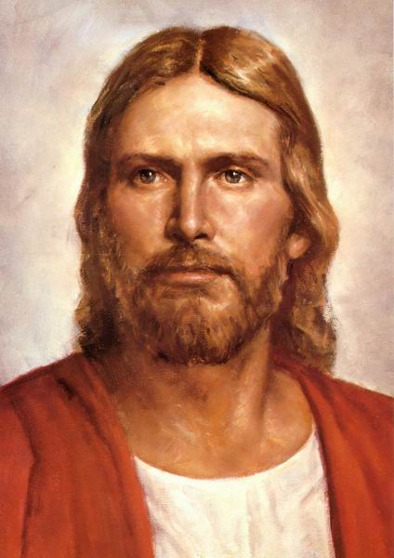
Jesus
Born of a Virgin (Miracle Child)
Lived a Perfect Life
Performs Miracles
Dies For Our Sin
Rose from Death

Slide 19
2 Corinthians 5:21
God made the one who did not know sin to be sin for us, so that in Him we would be restored to a right relationship with God.

Slide 20
GUILTY
Me
Jesus

Slide 21
Jesus
Me
INNOCENT

Slide 22
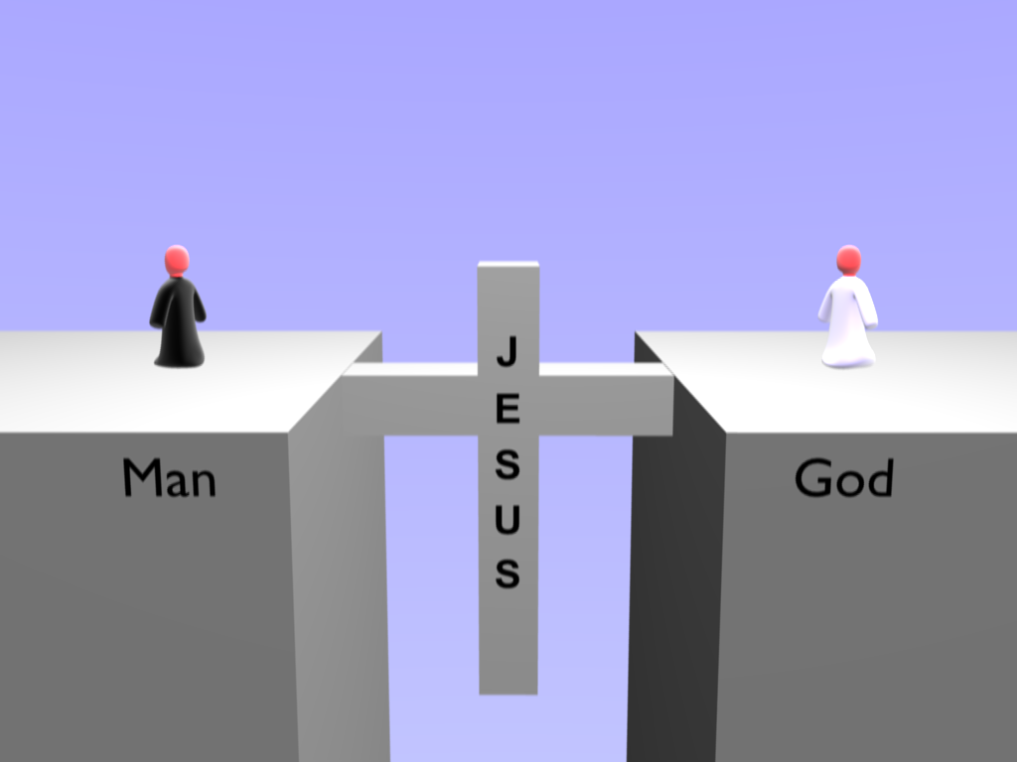
Notes:
God loved Man so much He sent His own son Jesus to become a man and live a perfect life and earn the right to eternal life.

Slide 23
John 5:24
Truly, truly, I say to you, whoever hears My word and believes Him who sent Me has eternal life. He does not come into judgment, but has passed from death to life.

Slide 24
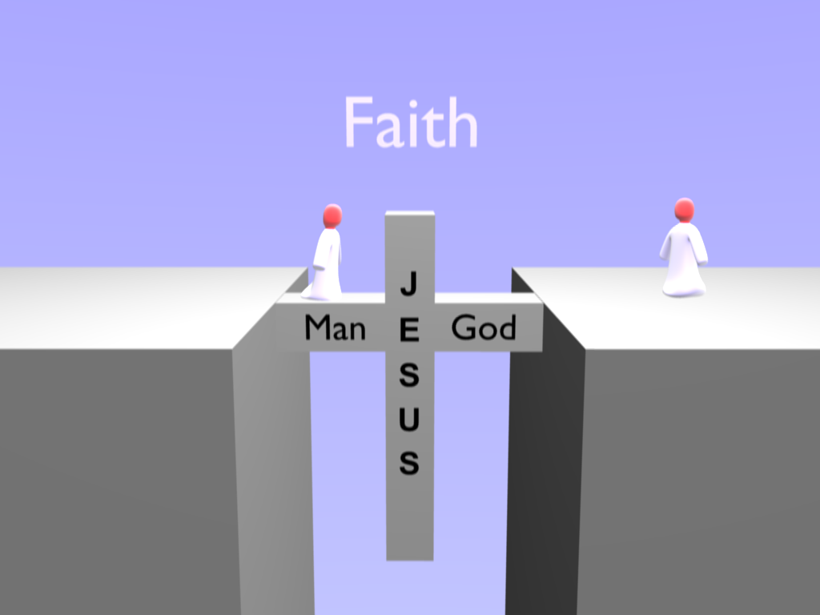
Notes:
To be saved, we have to trust in the work of Jesus. We have to step out on the bridge Jesus made, and trust that it will hold our weight to cross the divide—to believe that Christ’s death on the cross truly is the way to a restored relationship with Christ.

Slide 25
John 11:25-26
Jesus said to her, “I am the resurrection and the life. Whoever believes in me, though he die, yet shall he live, and everyone who lives and believes in me shall never die.
Do you believe this?”

Slide 26
Example Prayer .
God, I believe that Jesus Christ died on the cross to save me from sin and restore me to a relationship with God now and in heaven.
Because of what Jesus has done, I ask You to forgive me of my sin and restore me to You. I want a relationship with You. I want to trust Jesus as my Savior and follow Him.

Slide 27
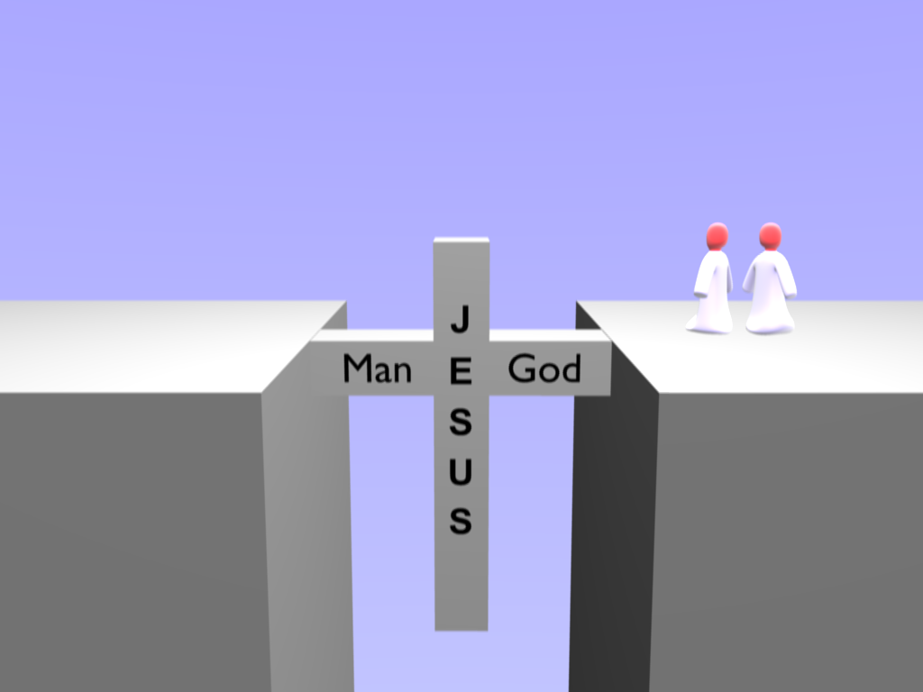
Notes:
The great news is: Jesus wants to share eternal life with you. The bible says if you confess with your mouth that Jesus is God and you believe in your heart he was raised from the dead then you will be saved.

Slide 28
Ephesians 2:8-9
For by grace you have been saved through faith, and that not of yourselves; it is the gift of God, not of good deeds, so that no one can boast.

Slide 29
John 17:7,14
I tell you the truth: it is to your advantage that I go away, for if I do not go away, the Helper will not come to you. But if I go, I will send Him to you. When the Spirit of truth comes, He will guide you into all the truth…for He will take what is Mine and declare it to you.

