Slide 1

WHO IS
ISA AL-MASIH?

Slide 2
Question #1
“al-Masih” means
“the anointed one,”
but why was Isa given
this special title?

Slide 3
Question #2
What significance
is there that Isa was anointed as a prophet, priest,
and king?

Slide 4
Question #3
How can we learn
more about
Isa al-Masih?

Slide 5
Surah 10:94-95
So when you are in doubt about what we have revealed to you, ask those who are reading the book that was before you. Truth has come to you from your Lord, so don’t be a doubter

Slide 6
Key Question
What does the Injil say about
Isa al-Masih?

Slide 7
WHAT ISA
SAID ABOUT HIMSELF. . .

Slide 8
Injil, John 6:35
“I am the bread of life; he who comes to Me will not hunger, and he who believes in Me will never thirst.”

Slide 9
Injil, John 8:12
“I am the Light of the world; he who follows Me will not walk in the darkness, but will have the Light of life.”

Slide 10
Injil, John 10:11
“I am the good shepherd; the good shepherd lays down His life for the sheep.”

Slide 11
Injil, John 11:25
“I am the resurrection and the life; he who believes in Me will live even if he dies.”

Slide 12
WHAT MAKES ISA
UNIQUE?

Slide 13
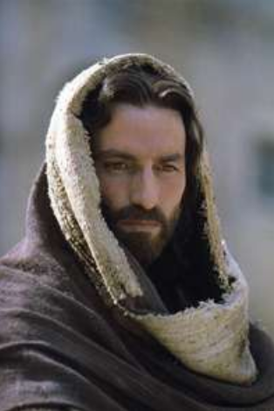
Isa
Born of a Virgin
(Miracle Child)
Lived a Perfect Life
Performs Miracles
Dies on a Cross
Rose from Death
Will defeat the Devil

Slide 14
Injil, Matthew 28:5-6
“The angel said to the women, “Do not be afraid; for I know that you are looking for Isa who has been crucified. “He is not here, for He has risen, just as He said…Come, see the place where He was lying.”

Slide 15
WHAT DOES ISA
EXPECT OF ME?

Slide 16
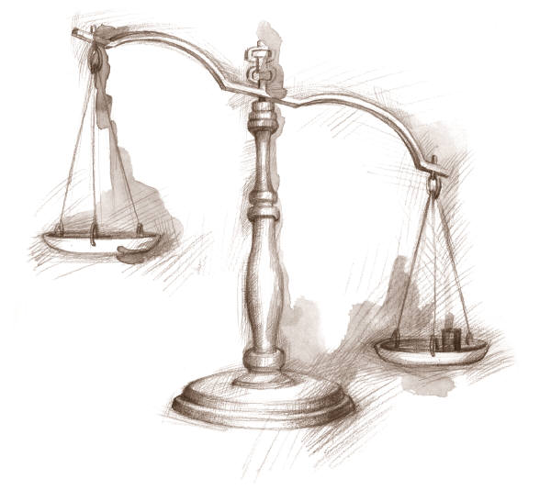

Slide 17
GUILTY
NOT GUILTY

Slide 18
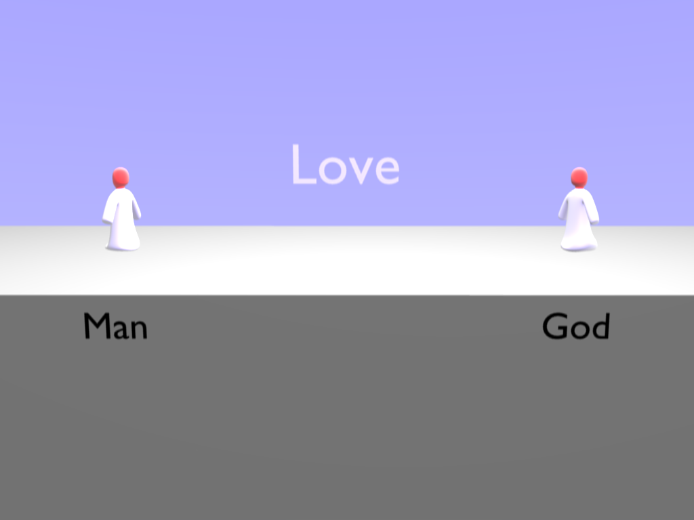
Allah
Notes:
God made Man to be in a Love relationship with Him forever. Love is what humans crave for; both to give and to receive God is love.

Slide 19
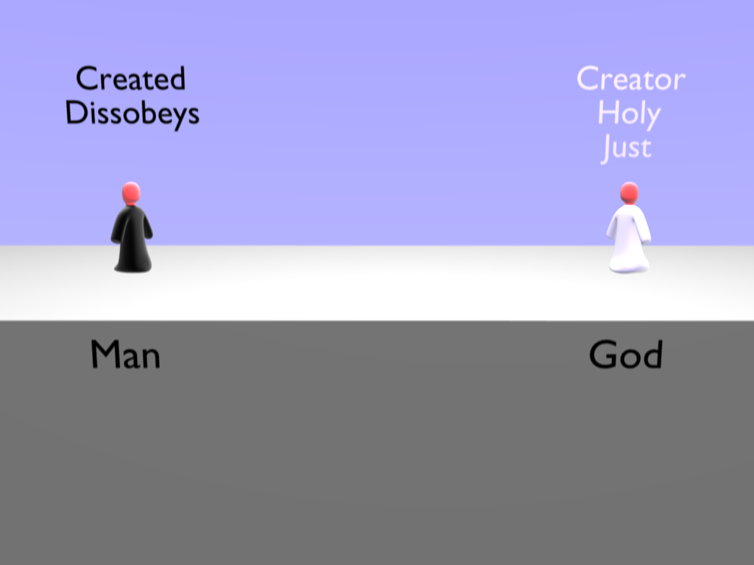
Allah
Notes:
Man was greedy and impatient, he decided to live for what he could have here and now, not caring what would happen in the future.

Slide 20
Paul’s Letter to the Romans 3:23
For all have sinned and fall short of the glory of God.

Slide 21
Isaiah 59:2
Your iniquities have made a separation between you and Allah, and your sins have hidden His face from you so that He does not hear.

Slide 22
Romans 6:23
The wages of sin is
death.
(“hell”)
(complete separation from God)

Slide 23
Matthew 7:21-23
Not everyone who says to me, ‘Lord, Lord,’ will enter the kingdom of heaven…many will say to me, ‘Lord, Lord, did we not do many mighty works in your name?’ And then will I declare to them, ‘I never knew you; depart from me…’

Slide 24
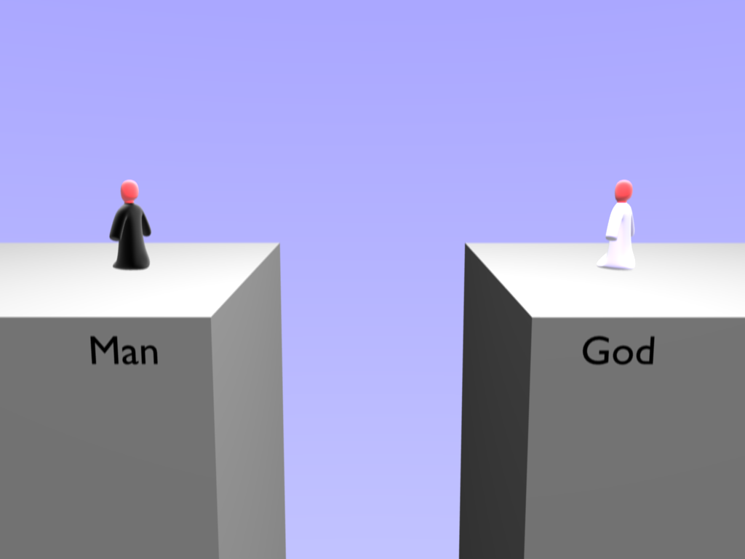
Allah
Death
Hell

Slide 25
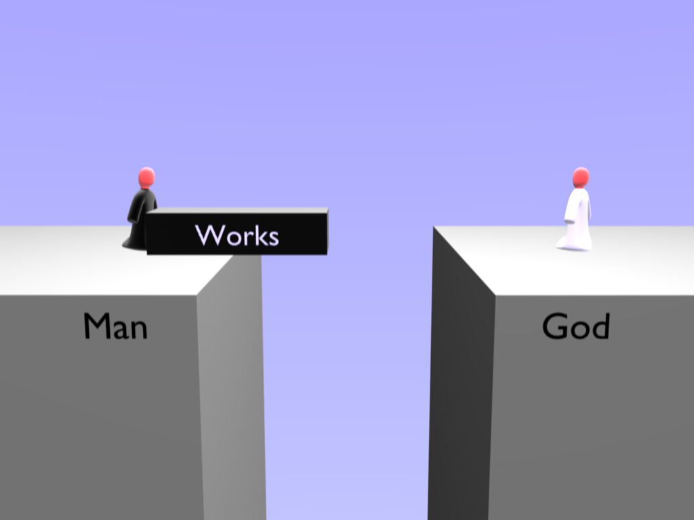
Allah
Notes:
Man hated this situation and tried make things right with God by good works and religious activity.

Slide 27
Isaiah 64:6
​​​​​​​We have all become
like one who is unclean, and all our righteous deeds are like a
polluted garment…

Slide 28
GUILTY
NOT GUILTY

Slide 29
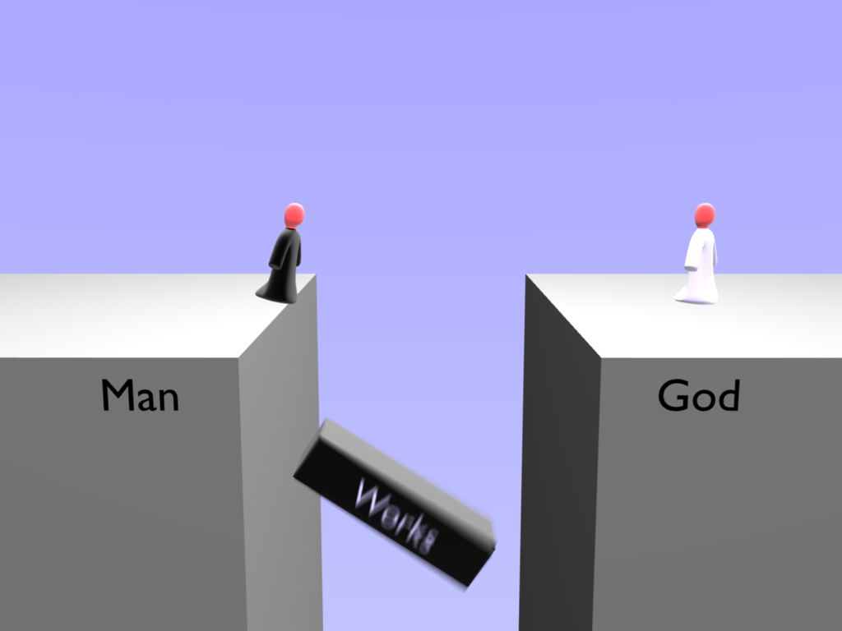
Allah
Notes:
It was no good, no amount of doing good will make a person pure once they have become impure. Even Man's attempts at good works stank to God. Rather than making things better they made things worse because Man became proud of his works.

Slide 30
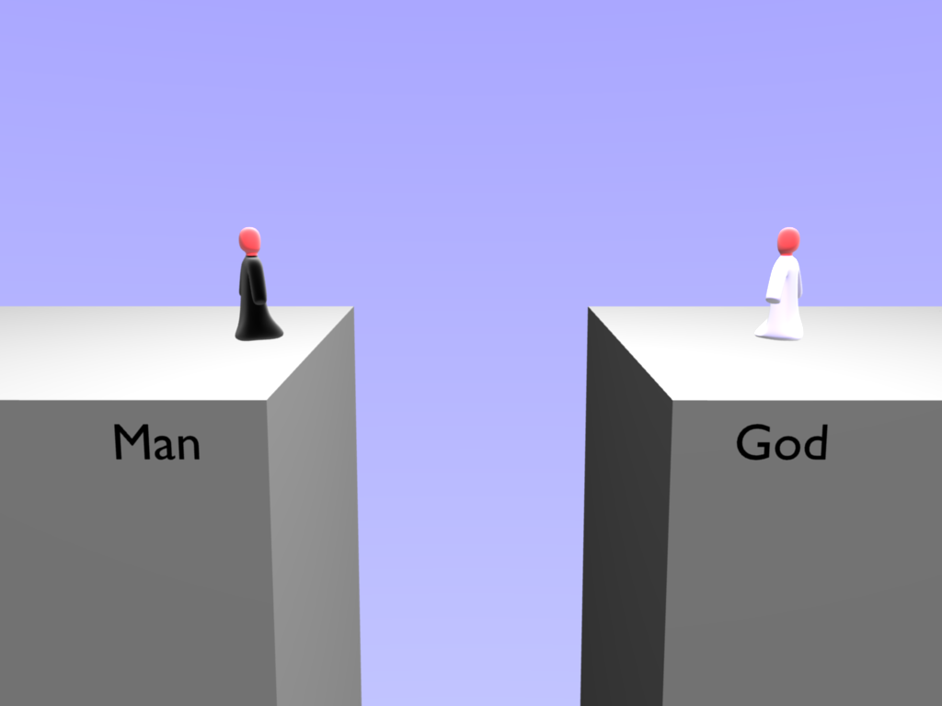
Allah
Notes:
But God was not happy with this situation because he still loved Him. The only way for Man to come back to God was if God made a way. God loved Man so much He sent His own son Jesus to become a human being to be born as a Man.

Slide 31
John 3:16
For Allah so loved the world, that He gave His only Son, that whoever believes in Him should not perish but have
eternal life.

Slide 32
Isa
Born of a Virgin
(Miracle Child)
Lived a Perfect Life
Performs Miracles
Dies For Our Sin
Rose from Death
Will Defeat Devil

Slide 33
2 Corinthians 5:21
Allah made the one
who did not know sin
to be sin for us,
so that in Him we would be restored to a right relationship with Allah.

Slide 34
GUILTY
Me
Isa

Slide 35
Isa
Me
INNOCENT

Slide 36
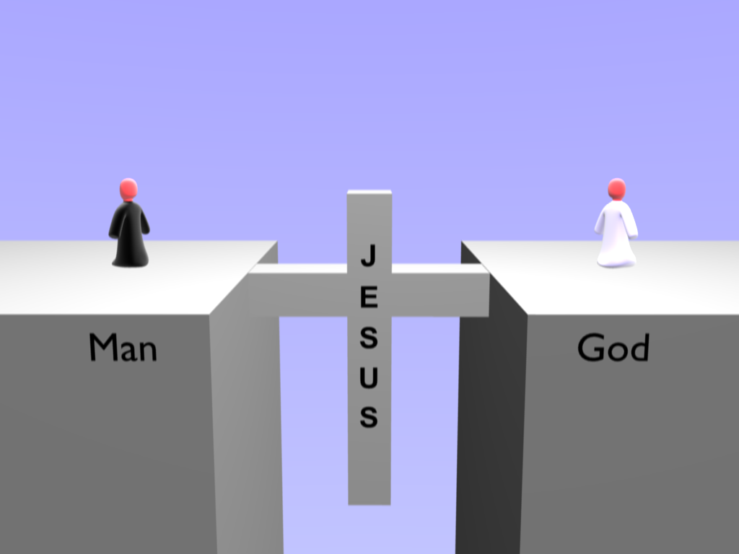
I
S
A
Allah
Notes:
God loved Man so much He sent His own son Jesus to become a man and live a perfect life and earn the right to eternal life.

Slide 37
John 5:24
Truly, truly, I say to you, whoever hears My word and believes Him who sent Me has eternal life.
He does not come into judgment, but has passed from death to life.

Slide 38
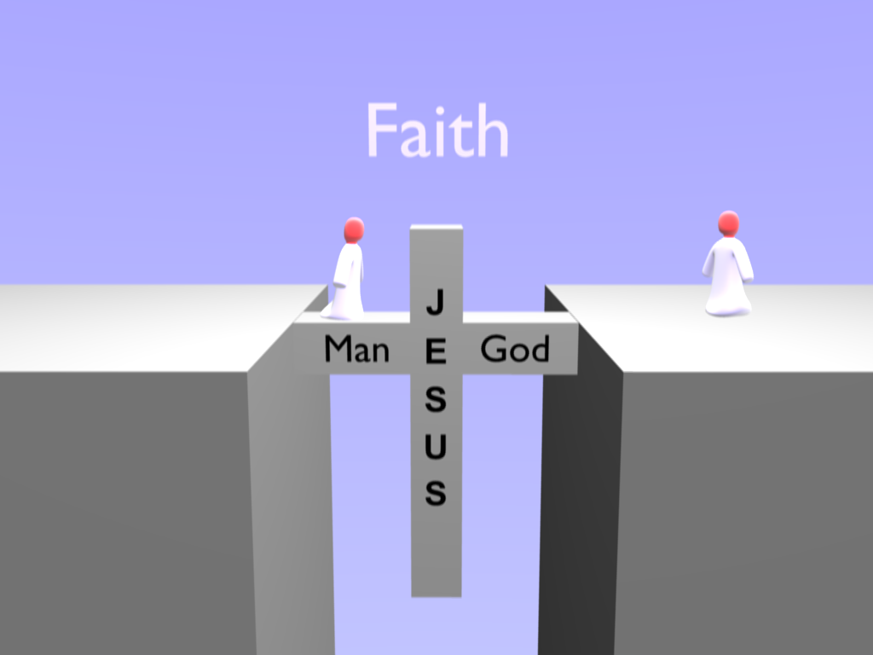
I
S
A
Allah
Notes:
To be saved, we have to trust in the work of Jesus. We have to step out on the bridge Jesus made, and trust that it will hold our weight to cross the divide—to believe that Christ’s death on the cross truly is the way to a restored relationship with Christ.

Slide 39
John 11:25-26
Isa said to her, “I am the resurrection and the life. Whoever believes in me, though he die, yet shall he live, and everyone who lives and believes in me shall never die.
Do you believe this?”

Slide 40
Example Prayer .
Allah, I believe that Isa died on the cross to save me from sin and to reconcile me to you, both now and in heaven.
Because of what Isa has done, I ask You to forgive me of my sin and restore me to You. I want to trust Isa as my Savior and follow Him.

Slide 41
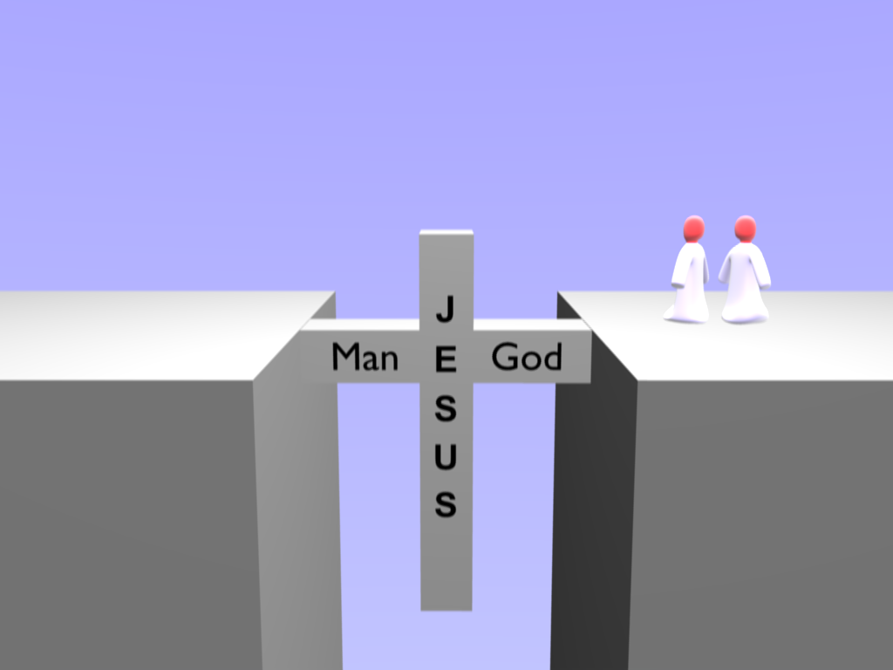
I
S
A
Allah
Notes:
The great news is: Jesus wants to share eternal life with you. The bible says if you confess with your mouth that Jesus is God and you believe in your heart he was raised from the dead then you will be saved.

Slide 42
Ephesians 2:8-9
For by grace you have been saved through faith, and that not of yourselves; it is the gift of Allah, not of good deeds, so that no one can boast.

Slide 43
John 17:7,14
I tell you the truth: it is to your advantage that I go away, for if I do not go away, the Helper will not come to you. But if I go, I will send Him to you. When the Spirit of truth comes, He will guide you into all the truth…for He will take what is Mine and declare it to you.

